Slide 1
NYC DSA Web-Scraping Project
Where next, Eataly asks?
Expandeth to wh're, eataly asks
By Mohamad Sayed

Slide 2
Why Eataly?
The famed International Italian marketplace has grown rapidly over the past dozen of years, so where could it head to next?

Slide 3


1. Intro
The history of Eataly in the US
First Store: New York City, Summer ‘10
Expansion to the West Coast Las Vegas June ‘16 Los Angeles October ‘17
Predicting Further Growth Plenty of untouched metropolitan cities, namely San Francisco and Miami
Notes:
Mayor Michael Bloomberg attended the opening, praising Eataly for creating 300 new jobs. Two weeks after opening, there were still lines extending down Fifth Avenue to get into the store and it has since been very positively reviewed by the press.The New York Eataly was originally planned for a smaller space near Rockefeller Center.
In October 2017 Eataly Century City location opened at the newly remodeled $1 billion Westfield Century City Mall in Los Angeles County. Covering 67,000 square feet, Eataly L.A. surpassed Eataly Chicago to become the largest Eataly in the United States

Slide 4
La grande domanda è ..
Key factors that could be key in the expansion of Eataly in the US

Slide 5
Project Scope
Understanding Eataly’s market strategy through Yelp reviews of existing stores
Anticipate cities that could fit Eataly’s current stores by matching location specific social factors
Determine the city that fits best with Eataly’s existing locations for a lower-risk strategy

Slide 6
Scrape yelp reviews of potential cities for data:
Restaurant ratings
Price range of restaurants
Number of Reviews
Location
Determine factors based on collected data:
Frequency of restaurants go-ers with similar price power
Highest average rating given by foodies
Ratio of visits for high-end restaurant versus low-end
Flow of Procedures

Slide 7
2. Analysis I
What How do restaurant go-ers vary in their liking for Italian restaurants in different US cities
Result

Slide 8
Restaurant rating averages and standard deviation per city
City | Mean | Standard Deviation
Seattle, WA | 4.12 | 0.28
Miami, FL | 3.96 | 0.45
San Francisco, CA | 3.92 | 0.46
San Jose, CA | 3.90 | 0.39
Austin, TX | 3.87 | 0.45
Washington, DC | 3.80 | 0.48
With the lowest std dev and the highest mean, Seattle has the best market for Italian food
Washington DC is on the opposite spectrum of Seattle, with lower average ratings paired with higher variability

Slide 9
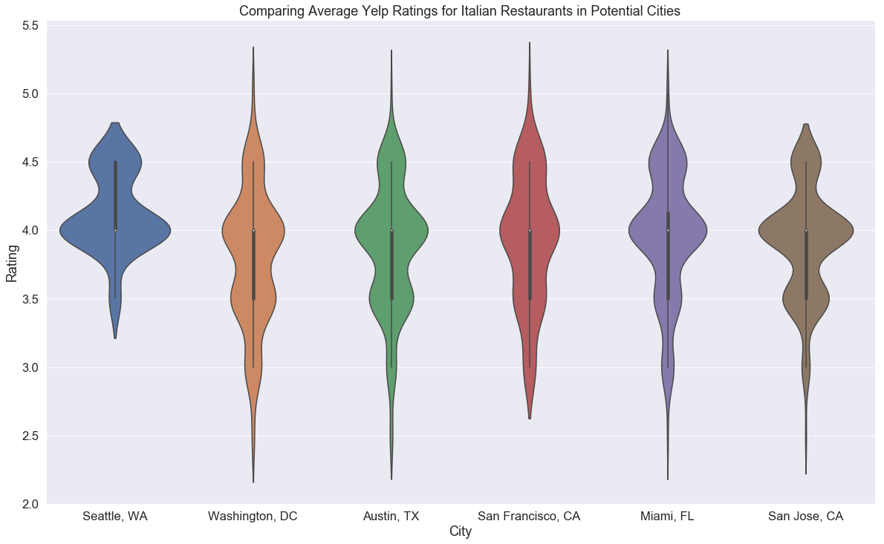

Slide 10
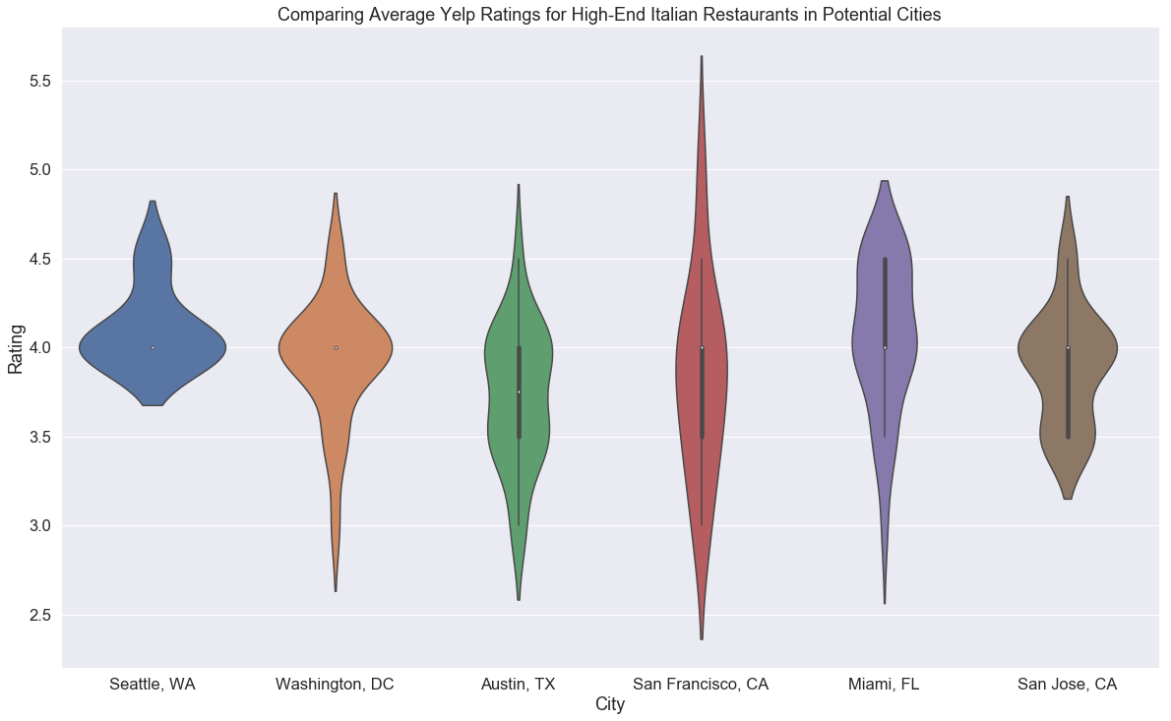

Slide 11
2. Analysis II
What Is there any noticeable trend of frequency for restaurants of different pricing ranges?
Result

Slide 12
Ratio of $$ reviews versus all price points
With the lowest ratio of affordable restaurants , DC seems like an untouched market
Seattle comes close, but Northern California is already highly competitive
City | Ratio
Washington, DC | 0.67
Seattle, WA | 0.73
Austin, TX | 0.73
Miami, FL | 0.74
San Jose, CA | 0.77
San Francisco, CA | 0.79

Slide 13
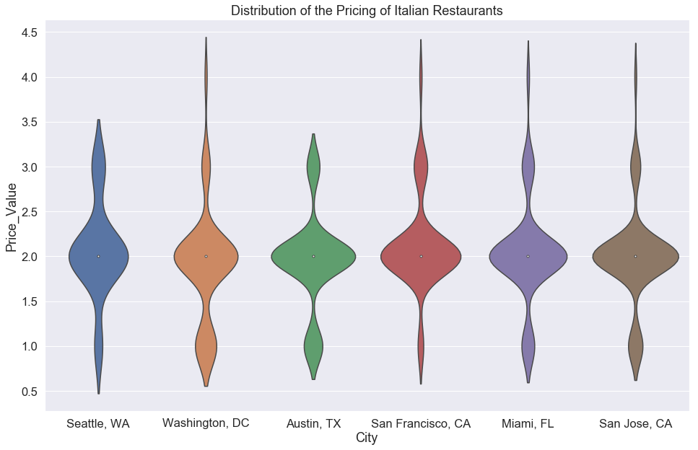

Slide 14
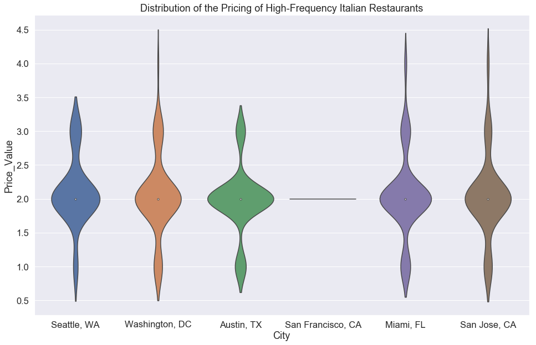
Notes:
Only restaurants with over 450 reviews are included

Slide 15
2. Analysis III
What Is there any noticeable trend of frequency for restaurants of different pricing ranges?
Result

Slide 16
Consumer Review Frequency
City | Nbr of Reviews | Nbr of Restaurants | Avg Nbr of Reviews per Rest.
Seattle, WA | 33,076 | 30 | 1103
Miami, FL | 160,683 | 180 | 893
San Jose, CA | 125,217 | 179 | 700
Washington, DC | 90,181 | 180 | 501
Austin, TX | 89,271 | 180 | 496
San Francisco, CA | 28,177 | 90 | 313
Seattle has the highest average number of reviews per restaurant
Restaurant go-ers are more critical and thus value restaurants more
More frequency in visiting Italian restaurants in Seattle and Florida than others

Slide 17
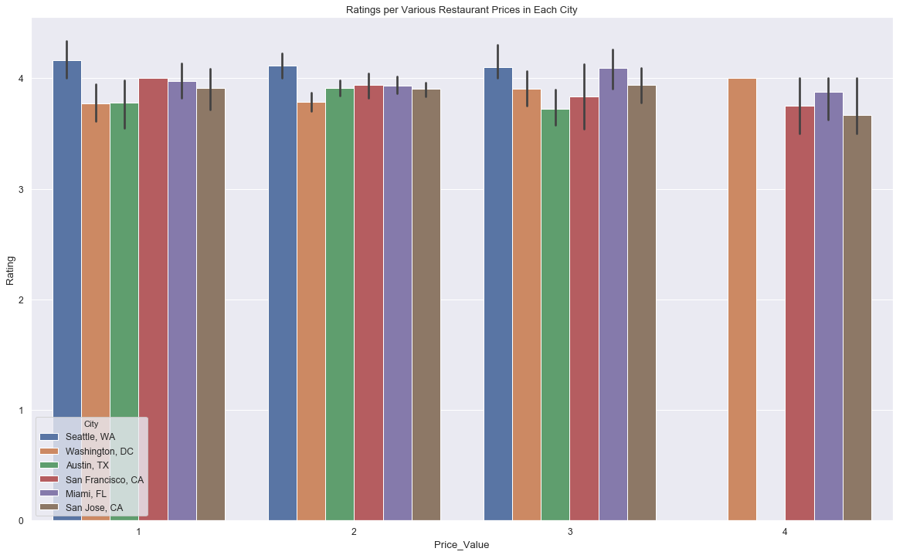

Slide 18
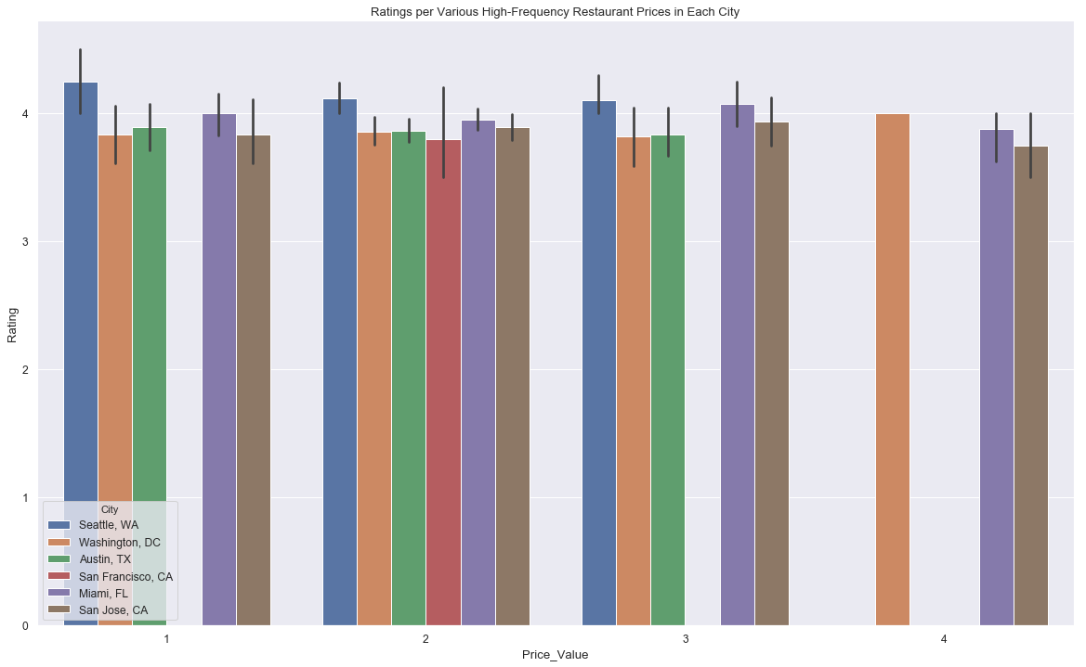

Slide 19
3. Closing
Wait, don’t bet on it just yet!
Results
Seattle has the best match of Italian restaurant goers with what fits Eataly’s current market
Data from Yelp can help determine a trend in customer behaviour, without reaching an absolute conclusion
Socio-economic factors can add further value to the analysis, by comparing similarities within regions
What’s next?

Slide 20
Future Work
Create a metric for rating each city per Socio-economic factors
Comparing Italian restaurants with other cuisines to further understand restaurant go-er’s desires
Implement a grade system for a more robust and objective assessment of location like-li-hood

Slide 21
Grazie Mille!
Any questions?

Slide 22
Grazie Mille!
No?!
Come on, por favore!

